Slide 1
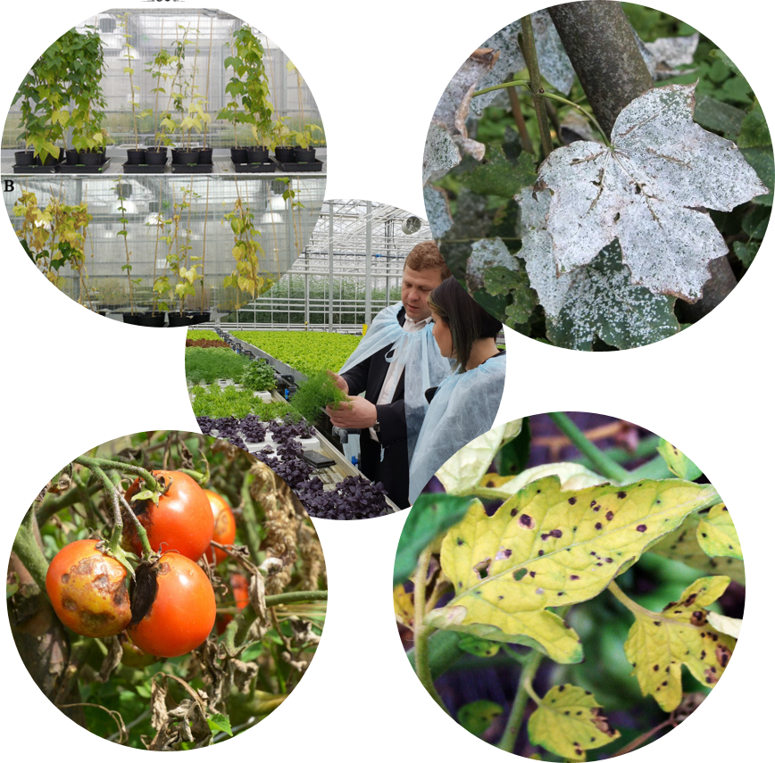
GREEN HOUSE MONITORING SYSTEM
TEAM 38

Slide 2
CONTENTS
PROBLEM STATEMENT
OUTCOMES
IMPACT
DESCRIPTION
ARCHITECTURE
DEMO & ANIMATED VIDEO

Slide 3
PROBLEM STATEMENT
These are the problems faced in current greenhouse monitoring systems
Different behaviors of plants under different conditions
Various disorders of plants
Taking manual measurements of information of the plants
Inefficiency of labor system
Unnecessary higher cost for maintenance

Slide 4
OUTCOMES
Higher cost for maintenance-In current greenhouses, the workers continuously observe the plant growth. In that case, workers will be tired and labor system would be inefficient. So, there would be an unnecessary higher cost for maintenance.
Harvest wastage – Plants respond differently under unbalanced environmental conditions and can have different kinds of disorders. It leads to production failures in greenhouses. As well, the crop yield may not be harvested at the right moment.

Slide 5
IMPACT
Plant Diseases
Huge Harvest Wastage
Unnecessary Expensive Maintenance
These key problems have been observed as the major issues in current Greenhouse Systems. We simulated the development of image analysis and computer vision methods. So “Greenhouse Monitoring System based on image spectral Data” will make high impact on maximizing the harvest and reduce maintenance cost in Greenhouses by tracking the phases of plant harvest, identifying any plant disorder and tracking the plant growth.

Slide 6
DESCRIPTION
Functionalities of the system
Extract images from the video file.
Extract features from images.
Store those images and features in a database.
Data processing and data analysis using ML Model
Data Visualization
Data Prediction and generate reports

Slide 7
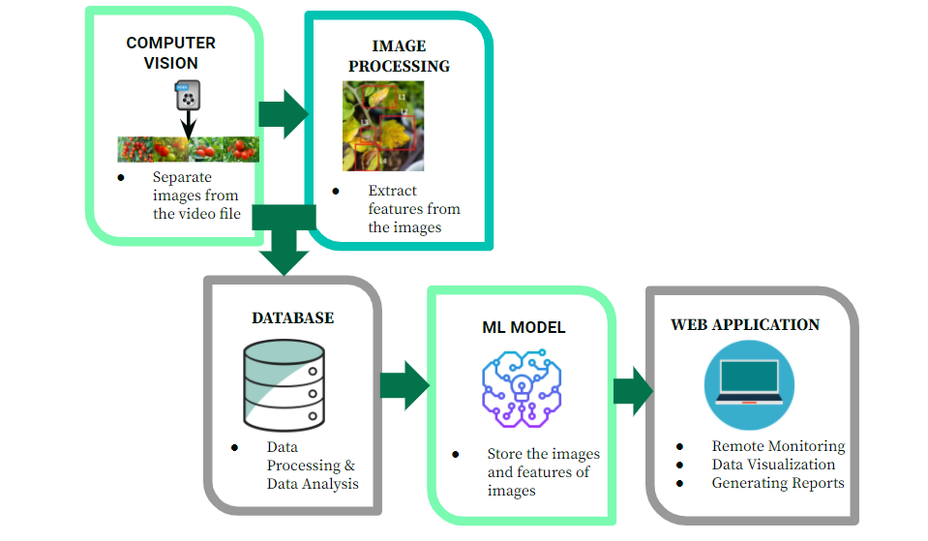
ARCHITECTURE

Slide 8
DEMO & ANIMATED VIDEO

Slide 9
Q & A

Slide 10
THANK YOU!

